Slide 1
Project Presentation of IOHE
On
SmartSpace
Amit Kumar Sah 2210991253
Adarsh Ranjan 2210991179
Ashish Ranjan 2210991402
Supervised By: Dr. Ajay Kumar
Department of Computer Science and Engineering,
Chitkara University, Punjab

Slide 2
Introduction
1.1 Background
Manual Management: Seminar halls and study rooms are managed manually without a proper system.
Availability Problems: Students do not know if a room is available in real time, which causes wasted time and booking clashes.
Poor Resource Usage: Some users keep spaces occupied for too long because there are no time limits.
Lack of Monitoring: There is no central system to track room usage or make sure all students get fair access to facilities.
1.2 Problem Statement
The current management of shared university spaces is inefficient due to the absence of a centralized digital system. Manual booking processes lead to scheduling conflicts, lack of real-time availability information, poor resource utilization, and unfair access to facilities. Additionally, there is no proper monitoring system to manage room usage effectively.
2

Slide 3
Objectives
The main objectives of SmartSpace are to improve the management and utilization of shared university spaces through a smart and centralized digital platform.
Digital Management: Develop a digital system for booking and managing shared university spaces efficiently.
Role-Based Access: Organize users through roles such as Community Head and Community Member for better management and coordination.
Fair Resource Allocation: Provide fair and transparent access to seminar halls and study rooms for all users.
Efficient Monitoring: Improve the monitoring and utilization of university resources through centralized management.
Time-Based Usage Control: Set proper time limits for room usage to avoid unnecessary occupation and ensure better availability.

Slide 4
Proposed Solution
The proposed system is a smart digital platform designed to manage shared university spaces such as seminar halls, study rooms, and meeting rooms in an easy and organized way. The system helps students and administrators book, monitor, and manage spaces efficiently without manual work.
Main Functions of the System:-
Online Room Booking: Students and faculty can book seminar halls or study rooms online through the system without visiting the office physically.
Real-Time Availability Checking: Users can instantly check whether a room is available or already booked, which helps avoid confusion and scheduling conflicts.
Time-Based Booking System: The system allows bookings for a limited time period so that resources are used fairly and no one occupies a room for too long.
Role-Based Access: Different roles such as Community Head and Community Member are provided to manage activities in a structured way. Community Heads can monitor and approve bookings if required.
4

Slide 5
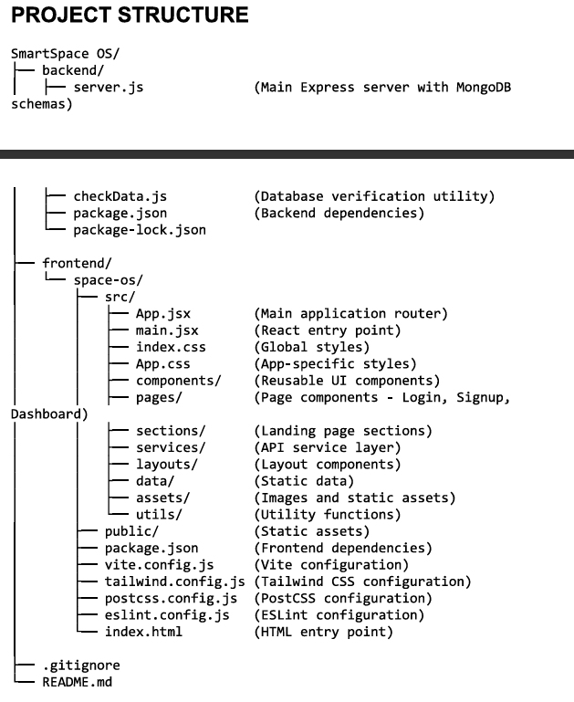
Project Structure

Slide 6
TECHNOLOGIES AND TOOLS
SmartSpace is built using the MERN Stack, which provides a scalable, secure, and centralized platform for managing shared university resources efficiently.
Technologies:-
React.js (with Vite): Used to create a fast, dynamic, and user-friendly interface.
Node.js & Express.js: THandles the server-side operations of the application.
MongoDB: A NoSQL database used to store application data efficiently.
JWT (JSON Web Tokens): Used for secure user authentication and authorization.
Tailwind CSS: Used for designing a clean, responsive, and professional interface.
REST APIs: Enable smooth communication between the frontend and backend.

Slide 7
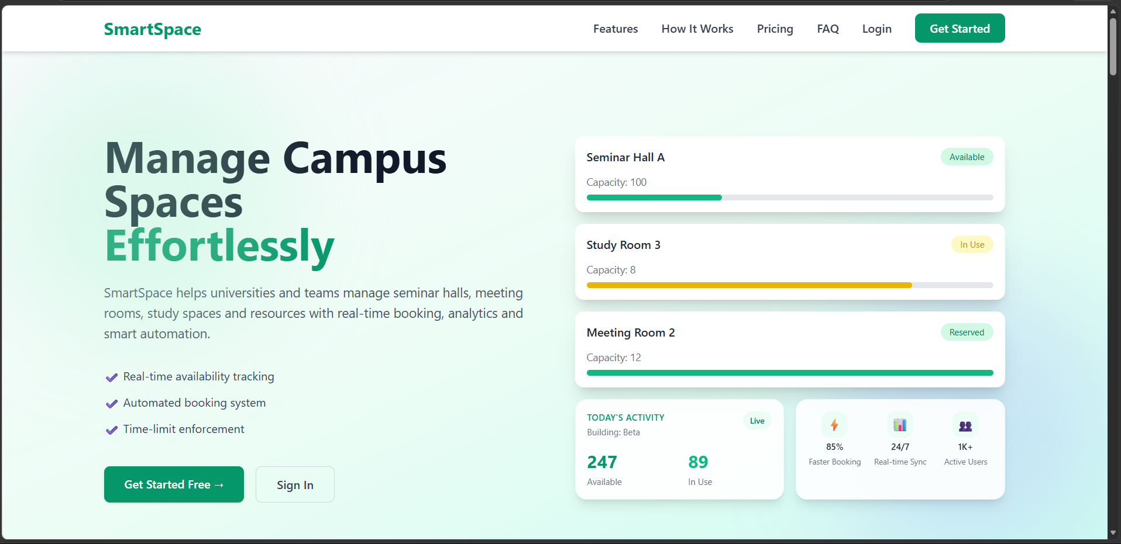
VISUAL REPRESENTATION

Slide 8
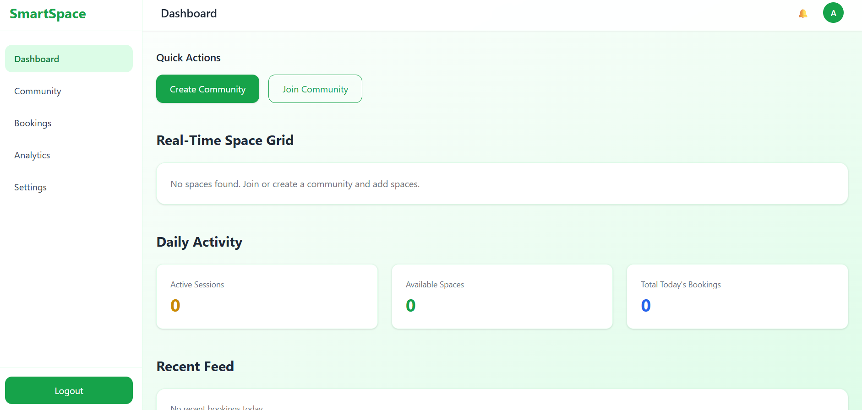
VISUAL REPRESENTATION

Slide 9
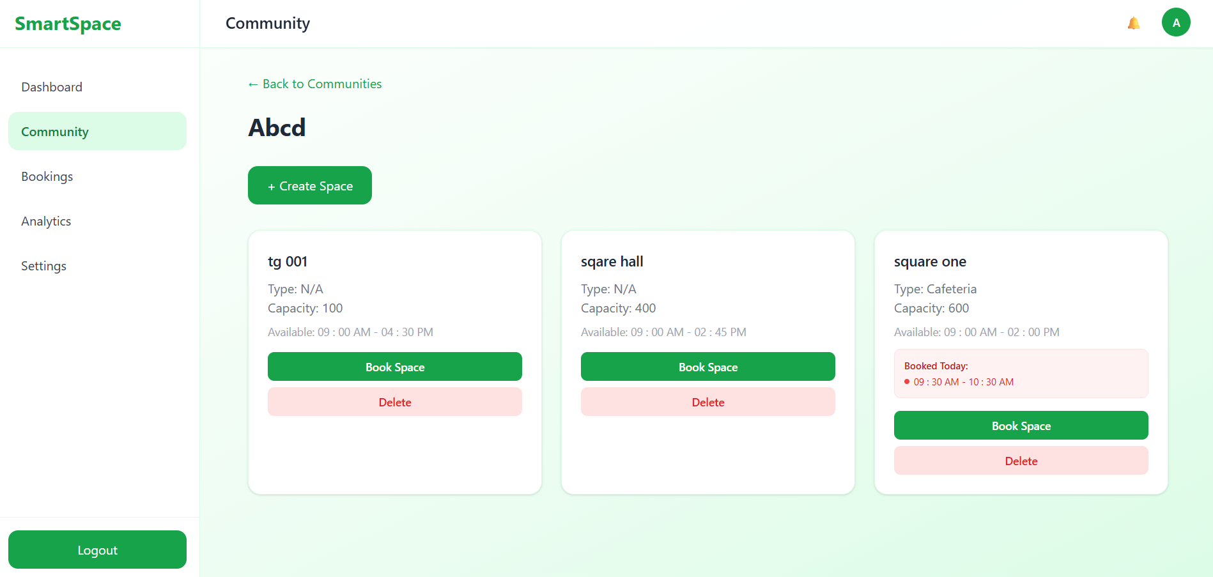
VISUAL REPRESENTATION

Slide 10
Future Scope
The SmartSpace system can be improved further by adding more advanced features and technologies in the future. These improvements will make the platform smarter, more secure, and more useful for students and universities.
QR Code Access: Add QR code-based room entry and verification.
Automatic Expiry: Introduce automatic cancellation for unused bookings.
Smart Notifications: Add reminders and booking updates for users.
Mobile Application: Develop a mobile app for easier access.
University Integration: Connect the system with university portals and student IDs.

Slide 11
Conclusion
SmartSpace provides a smart and efficient solution for managing shared university spaces digitally. The system helps students and administrators easily book and monitor seminar halls and study rooms in real time. By reducing manual work, avoiding booking conflicts, and ensuring fair resource usage, SmartSpace improves overall campus management and creates a more organized and user-friendly environment.

Slide 12
Bibliography/References
React (Official Documentation) Meta. React – A JavaScript Library for Building User Interfaces. https://react.dev
Vite (Official Documentation) Evan You. Vite – Next Generation Frontend Tooling. https://vitejs.dev
Tailwind CSS (Official Documentation) Tailwind Labs. Tailwind CSS – Utility-First CSS Framework. https://tailwindcss.com/docs
MongoDB (Official Documentation): MongoDB Inc. The Document Database for Modern Applications.
https://www.mongodb.com/docs
Express.js (Official Documentation) OpenJS Foundation. Express – Fast, Unopinionated Web Framework for Node.js. https://expressjs.com
Node.js (Official Documentation): OpenJS Foundation. Node.js – JavaScript Runtime built on Chrome's V8 JavaScript engine.
https://nodejs.org/en/docs

Slide 13
Thank You
13

